Slide 1


Mark D Lindner
June 20, 2024

Slide 2


Outline
Executive Summary
Introduction
Methodology
Results
Conclusion
Appendix

Slide 3

Executive Summary
This project focuses on analyzing SpaceX's launch data to predict the success of their first stage rocket landings. By utilizing data science techniques, the project aims to identify key variables influencing landing outcomes and to develop predictive models that can assist in optimizing launch strategies and reducing costs.
Data Collection: Data was gathered using the SpaceX API and web scraping from Wikipedia, resulting in comprehensive datasets on SpaceX launches.
Data Wrangling: The collected data was cleaned, irrelevant entries were removed, and missing values were handled to produce two main datasets (dataset_part_1.csv and dataset_part_2.csv).
Exploratory Data Analysis (EDA): EDA was conducted using SQL and data visualization techniques
Interactive Visual Analytics:
An interactive map using Folium was created to visualize launch sites and outcomes.
A dashboard with Plotly Dash was developed to explore relationships between launch success, payload mass, and booster versions.
Predictive Analysis:
Four classification models (Logistic Regression, SVM, Decision Tree, and KNN) were implemented and evaluated.
Predictive models utilized variables like flight number, payload mass, orbit type, and launch site to forecast outcomes.
All the models demonstrated good predictive validity but the Logistic Regression was perhaps slightly better than the others.
Key Findings:
Interactive tools and predictive models can help identify useful predictors, optimize launch strategies and improve cost efficiency, enhancing SpaceX's competitive edge in the market.
Launch sites near the equator and coastlines offer strategic advantages.
Significant predictors of launch success included flight number, payload mass, orbit type, and various other variables.
This comprehensive analysis demonstrates the power of data science in improving the understanding and optimization of launching payloads into orbit.

Slide 4

Introduction
SpaceX launches payloads into different orbits for different clients.
They reduce their costs by landing and re-using the large, stage 1 rockets that push the payloads into orbit.
They also make large amounts of data on their rocket launches available to the public.
We want to know if we can use the data they provide to accurately predict if the stage 1 rocket will land successfully and be available for re-use.
We want to know which variables will be useful to make accurate predictions, which models have better predictive validity, and how accurate that model actually is.

Slide 5

Section 1

Slide 6

Methodology
Executive Summary
Data collection methodology: Utilized SpaceX API and web scraping from Wikipedia to gather data on SpaceX launches.
Perform data wrangling: Cleaned the data, removed irrelevant entries, and handled missing values, resulting in two main datasets: dataset_part_1.csv and dataset_part_2.csv.
Perform exploratory data analysis (EDA) using visualization and SQL
Perform interactive visual analytics using Folium and Plotly Dash
Perform predictive analyses using classification models: identified relevant variables, built four models, conducted grid search to identify optimum hyperparameters and evaluated numerous measures of predictive accuracy to select best predictive model

Slide 7
Data Collection – SpaceX API
Import Libraries: requests, pandas, numpy, datetime
Configure pandas options to display all columns and column data.
Define Functions
getBoosterVersion(data): Calls SpaceX API for rocket information.
getLaunchSite(data): Calls SpaceX API for launchpad information.
getPayloadData(data): Calls SpaceX API for payload information.
getCoreData(data): Calls SpaceX API for core information.
Initialize Global Variables
Define global lists for various attributes (e.g., Booster Version, Payload Mass, Orbit, etc.).
API Calls
Call getBoosterVersion(data): Populate Booster Version list.
Call getLaunchSite(data): Populate Longitude, Latitude, Launch Site lists.
Call getPayloadData(data): Populate Payload Mass, Orbit lists.
Call getCoreData(data): Populate Outcome, Flights, Grid Fins, Reused, Legs, Landing Pad, Block, Reused Count, Serial lists.
Create Launch Dictionary: Combine all collected data into a dictionary (launch_dict).
Convert to DataFrame: Convert launch_dict to a pandas DataFrame (launch_df).
Data Cleaning
Filter out Falcon 1 data.
Reset Flight Number for the cleaned dataset.
Handle missing values by replacing NaN in PayloadMass with the mean value.
Save the cleaned DataFrame to a CSV file (dataset_part_1.csv).
GitHub URL of completed SpaceX API calls notebook (including completed code cell and outcome cell): https://github.com/Mark-CSR/IBM-Data-Science-Professional-Certificate--Capstone-Project/blob/main/240329%20spacex-data-collection-api.ipynb
Import Libraries
Define Functions
Initialize Global Variables
API Calls
Create Launch Dictionary
Convert to DataFrame
Data Cleaning
Save DataFrame
dataset_part_1.csv

Slide 8
Data Collection - Scraping
Import Libraries: sys, requests, BeautifulSoup, re, unicodedata, pandas
Define Functions
date_time: return date and time from HTML table.
booster_version: return booster version from HTML table.
landing_status: return landing status from HTML table.
get_mass: return mass in kg from HTML table.
extract_column_from_header: return landing status from HTML table.
Identify URL of Wikipedia web page to be scraped.
Use HTTP GET method to pull HTTP into response object.
Create BeautifulSoup object from HTML response.
Print soup object title to verify correct object: List of Falcon 9 and Falcon Heavy launches – Wikipedia
Third table is target that contains launch records: Extract column names from HTML table header.
Create empty dictionary with column headers as keys.
Fill dictionary values with launch records extracted from table rows: Flight No., Launch Site, Payload, Payload Mass, Orbit, Customer, Launch Outcome, Version Booster, Booster Landing, Date, Time
Convert dictionary into dataframe: 100 rows x 11 columns
Save the cleaned DataFrame to a CSV file (spacex_web_scraped.csv).
GitHub URL of completed Wikipedia web page scraping notebook: https://github.com/Mark-CSR/IBM-Data-Science-Professional-Certificate--Capstone-Project/blob/main/240330%20Complete%20data%20collection%20with%20Web%20Scraping.ipynb
Import Libraries
Define Functions
Identify URL of Web Page
GET HTTP
Create Beautifulsoup Object
Extract Column Names
Create Empty Dictionary
Fill Dictionary with Records
Convert Dictionary into DataFrame
Save DataFrame as CSV FIle
8

Slide 9
Data Wrangling
Import Libraries: pandas, numpy
Read csv datafile from web page into pandas dataframe: dataset_part_1.csv
Calculate number of launches from each launch site
Produce counts of launches from each of 11 orbit types
List counts of 8 types of launch outcomes
Convert outcomes to 2 classes: 0 if bad outcome, 1 if successful outcome
Save outcome class in new variable: Class
Compute mean of all launches: 66.7% of launches are successful
Save dataframe to csv file: dataset_part_2.csv
GitHub URL of completed Wikipedia web page scraping notebook: https://github.com/Mark-CSR/IBM-Data-Science-Professional-Certificate--Capstone-Project/blob/main/240331%20SpaceX%20Data%20Wrangling.ipynb
Import Libraries
Read csv datafile
Counts from launch sites
Counts of different orbits
List of 8 launch outcomes
Convert outcomes to 0 or 1
Save outcomes 0 or 1 to Class
Mean of Class = 67%
Save DataFrame as CSV FIle
data_set_part_2.csv

Slide 10
EDA with SQL
Import Libraries: csv, sqlite3, sqlalchemy
Create sqlite3 database
Read Spacex.csv datafile from web page into pandas dataframe
Load csv file into table in sqlite3 database
SQL query to identify distinct launch sites
SQL query for records with launch sites beginning with CCA
SQL query to determine sum of payload mass of boosters launched by NASA
SQL query to determine average payload mass where booster version = F9 v1.1
SQL query to identify first date of successful landing outcome
SQL query of distinct booster versions with drone ship success and payload mass 4000-6000 kg
SQL query for count of booster versions with successful or failed landing outcomes
SQL query for distinct booster versions of launches with maximum payload mass
SQL query to identify month, year, landing outcome, booster version and launch site where year = 2015 and landing outcome = ‘Failure (drone ship)’
SQL query for count of different landing outcomes between June 4, 2010, and March 20, 2017, ordered alphabetically by landing outcome
GitHub URL of completed notebook: https://github.com/Mark-CSR/IBM-Data-Science-Professional-Certificate--Capstone-Project/blob/main/240401%20Exploratory%20Data%20Analysis%20SQL%20sqllite.ipynb

Slide 11
EDA with Data Visualization
Import Libraries: pandas, numpy, matplotlib, seaborn
Read dataset_part_2.csv into pandas dataframe
Visualization relationships between variables to identify predictors for outcomes
Scatter Plot: Flight Number by Payload Mass. As flight numbers increase, heavier payload masses are launched and there are more successful outcomes
Scatter Plot: Flight Number by Launch Site. Different Some launch sites have more successful outcomes than others, especially with later flights
Scatter Plot: Payload Mass by Launch Site. Payload Mass is not evenly distributed across launch sites.
Bar Graph: Orbit Type by Class. Orbit Type is related to success rate. Four of the 11 Orbit Types have 100% success rates, one has 0% success rate
Scatter Plot: Flight Number by Orbit Type. Success rates improve with more flights but only for some Orbit Types
Scatter Plot: Payload Mass by Orbit Type. Some Orbit Types have more successful launches with heavier payloads. Other Orbit Types have a narrow range of Payload Masses and success rates seem unrelated to Payload Mass.
Line Graph: Average success rate by Year. Success rates increase over time, from 0% in 2010-2013 to 84% in 2020.
SUMMARY: Exploratory data analyses and visualizations help identify relationships between variables and identify variables that are predictors of success rate.
GitHub URL of completed notebook: https://github.com/Mark-CSR/IBM-Data-Science-Professional-Certificate--Capstone-Project/blob/main/240402%20Exploratory%20Data%20Analysis%20and%20Visualization.ipynb

Slide 12
Build an Interactive Map with Folium
Import Libraries: folium (MarkerCluster, MousePosition, DivIcon), wget, pandas
Read spacex_launch_geo.csv into pandas dataframe
Create folium map with NASA Johnson Space Center at Houston, Texas as the center location.
At the location of NASA:
Add the label ‘NASA JSC’
A yellow circle with 1000 yard radius around the longitude and latitude of NASA.
A text popup ‘NASA Johnson Space Center’ when you click the mouse over the location.
Add labels, circles and popup text at the location of each of the other launch sites.
Add a line on the equator.
At each launch site, add markers for each launch from that site (green for success, red for failure)
MarkerCluster shows number of markers grouped together. When zoomed in and clicking on the MarkerCluster all the individual markers for each launch pop up with the appropriate color.
Add function to show MousePosition longitude and latitude on the top right corner of the map
Add function to calculate distance in km between two points based on longitude and latitude.
Add marker on the nearest point on the coastline to CCAFS SLC40 and label for 0.87 km distance.
Add markers and labels for distances between CCAFS SLC40 and nearest city, train station and highway.
SUMMARY: Markers added to the map show that all launch sites are near the coast, railways, highways, the equator and near but not too close to a city.
GitHub URL of completed notebook: https://github.com/Mark-CSR/IBM-Data-Science-Professional-Certificate--Capstone-Project/blob/main/240406%20Interactive%20Visual%20Analytics%20with%20Folium.ipynb

Slide 13
Build a Dashboard with Plotly Dash
Import Libraries: requests, pandas, dash (html, Input, Output), plotly, webbrowser, numpy
Create a dashboard application: SpaceX Launch Records Dashboard
Add a Launch Site Drop-down Input Component that shows All Sites by default, or allows selection of one of the four Launch Sites
Add a pie chart that shows percent of successful launches for each of the four launch sites by default, or success and failure rates if one of the four launch sites is selected
Add a range slider that allows the user to restrict the minimum to maximum payload range
Add a scatter plot of Payload Mass (kg) by Launch Success with a symbol for each launch, and different colors indicating different booster versions.
Add a callback function for site-dropdown as input and render pie chart based on selected site dropdown
Add a callback function for site-dropdown and payload slider as inputs to render scatter plot based on input
Open web browser and display output in window
SUMMARY: The default pie chart shows different success rates for different launch sites. The scatter plot shows success rates for different Payload Mass and Booster Versions. This dashboard allows the user to explore and visualize the relationships between launch sites, payload mass and booster version.
GitHub URL of completed notebook: https://github.com/Mark-CSR/IBM-Data-Science-Professional-Certificate--Capstone-Project/blob/main/240422%20Build%20a%20Dashboard%20Application%20with%20Plotly%20Dash.ipynb

Slide 14
Predictive Analysis (Classification)
Import Libraries: pandas, numpy, matplotlib, seaborn, sklearn
Define function to create confusion matrix
Load the dataset_part_2.csv and dataset_part_3.csv into dataframes
Predictors include Flight Number, Payload Mass, Fights, Block, Reused Count, and the following in separate columns with one hot coding: Orbit Types, Launch Sites, Serial Numbers, Grid Fins, Reused, and Legs
The predictors were all standardized into scales with a mean of 0 and standard deviation of 1
The Class variable of success or failure and predictors were read into numpy arrays, Y and X, respectively
The train_test_split function was used to randomize the records, and designate 80%:20% (n=72 or 18) of each array for training or testing, respectively
Models Examined: Logistic Regression, Support Vector Machine, Decision Tree and K Nearest Neighbors
Method:
The optimal hyperparameters of each model are identified with a grid search and 10-fold cross-validation using the training data.
The accuracy of each model is then determined on the test data using: Accuracy, Jaccard Score, F1 score, and a confusion matrix.
GitHub URL of completed notebook: https://github.com/Mark-CSR/IBM-Data-Science-Professional-Certificate--Capstone-Project/blob/main/240423%20SpaceX%20Machine%20Learning%20Prediction.ipynb
Import Libraries
Read csv datafiles
Normalize predictor variables
Convert Predictor/Outcome
Variables to numpy arrays
Select 4 models for testing
Use Grid Search to Identify Optimal Hyperparameters
Determine accuracy of each model using optimal hyperparameters and test data
Compare models using measures of accuracy

Slide 15

Results
Exploratory Data Analysis (EDA):
Conducted EDA using SQL and data visualization techniques.
Success rates of launches varied significantly by launch site and orbit type.
Numerous variables correlated with higher success rates.
Success rates improved with experience, reaching 84% by 2020.
Interactive Visual Analytics:
Created an interactive map using Folium, displaying launch sites and outcomes.
Developed a dashboard with Plotly Dash to visualize launch success rates by site, payload mass, and booster version.
Predictive Analysis:
Implemented and evaluated four classification models: Logistic Regression, SVM, Decision Tree, and KNN.
All models accurately predicted launch outcomes. Logistic Regression may have been slightly better than the other models.
Models utilized predictors like flight number, payload mass, orbit type, and launch site to forecast launch outcomes.
Key Findings:
Launch sites near the equator and coastlines have strategic advantages.
Flight number, Payload mass, orbit type and numerous other variables were significant predictors of launch success.
Interactive tools and predictive models can aid in optimizing launch strategies and improving cost efficiency.

Slide 16

Section 2

Slide 17
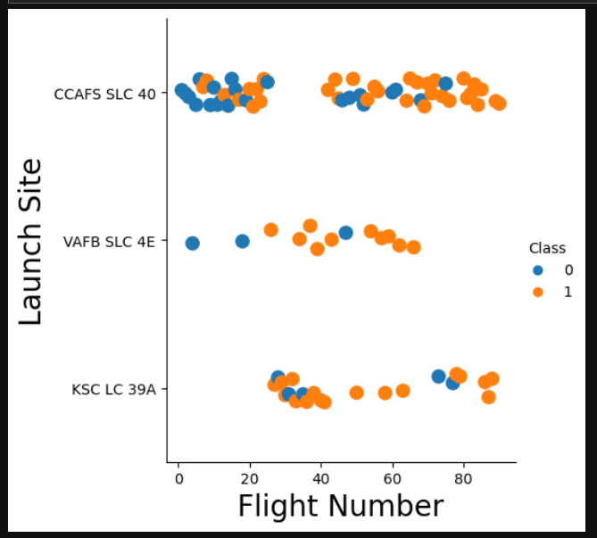
Flight Number vs. Launch Site
Flight Number is shown on the x axis.
Launch Sites are indicated on the y axis
Each successful launch is indicated with a yellow circle, failed launches are indicated by blue circles.
Different launch sites have different success rates.

Slide 18
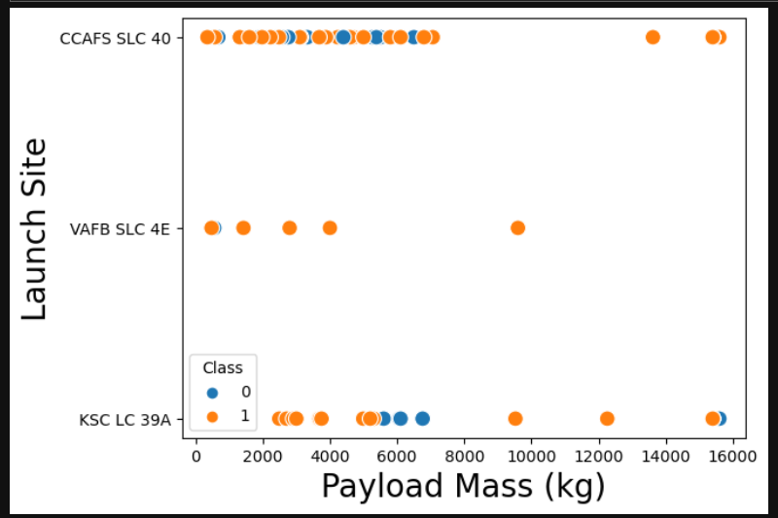
Payload vs. Launch Site
Payload Mass (kg) is shown on the x axis.
Launch Sites are indicated on the y axis
Each successful launch is indicated with a yellow circle, failed launches are indicated by blue circles.
Payload mass is not evenly distributed across the different Launch Sites. For example, the VAFB-SLC launch site had no rockets launched with payloads greater than 10000.

Slide 19
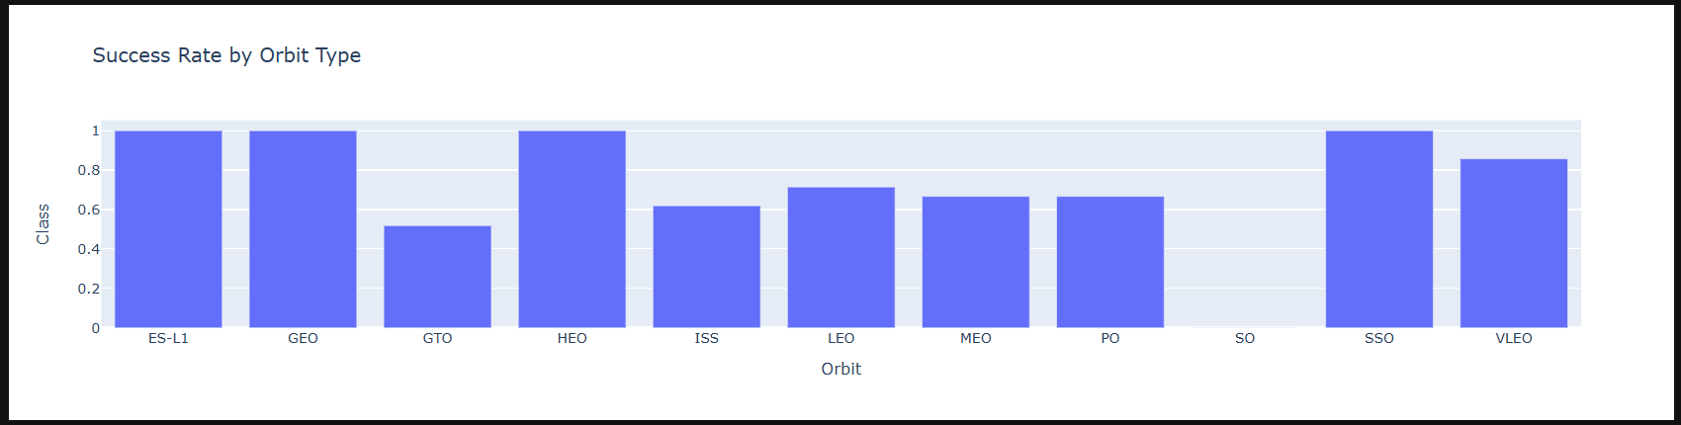
Success Rate vs. Orbit Type
Orbit Types are indicated on the x axis.
The average success rate for each Orbit Type is shown on the y axis.
Note that success rates for some Orbit Types are 0% (SO), but 100% for others (ES-L1, GEO, HEO and SSO)

Slide 20
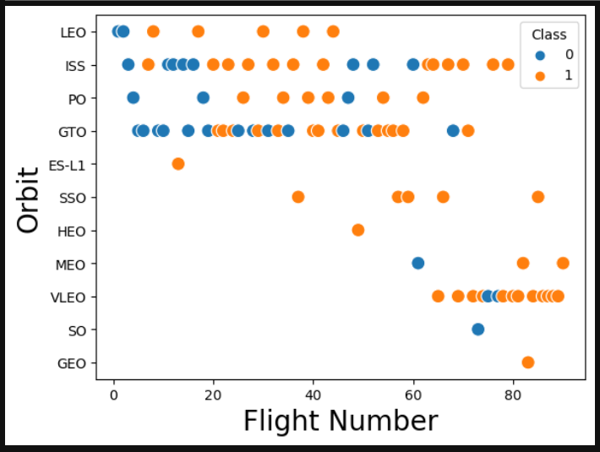
Flight Number vs. Orbit Type
Flight Number is shown on the x axis.
Orbit Types are indicated on the y axis
Each successful launch is indicated with a yellow circle, failed launches are indicated by blue circles.
In the LEO orbit the Success appears related to the number of flights; but, there seems to be no relationship between flight number and success in the GTO orbit.

Slide 21
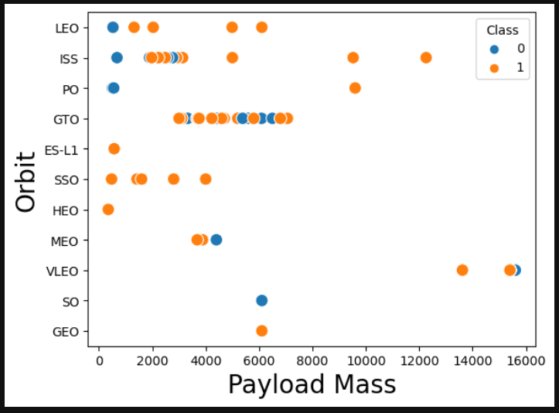
Payload vs. Orbit Type
Payload Mass (kg) is shown on the x axis.
Orbit Types are indicated on the y axis
Each successful launch is indicated with a yellow circle, failed launches are indicated by blue circles.
With heavy payloads the rates of successful landings seem high for PO, LEO and ISS.
However, with the GTO Orbit Type we cannot determine if there is a relationship between success rate and Payload Mass.

Slide 22
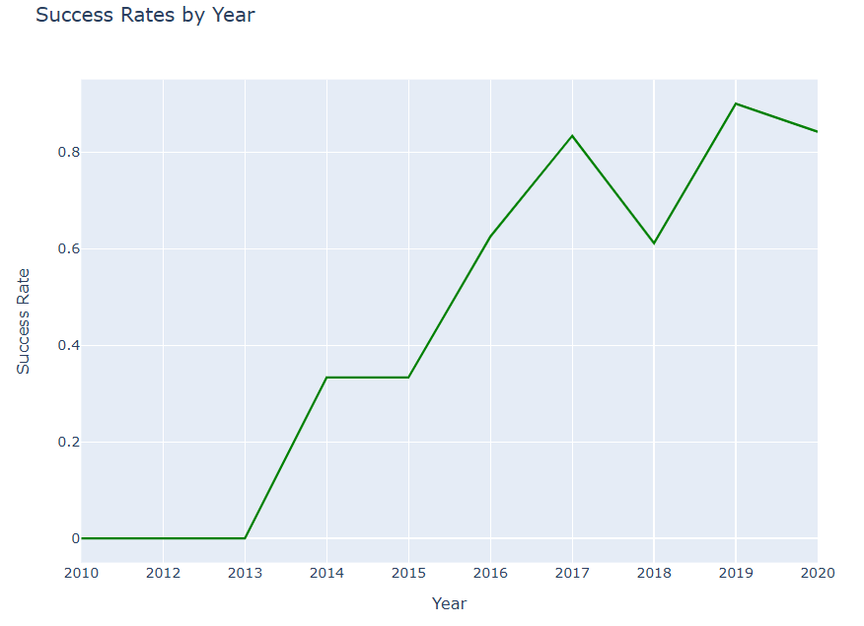
Launch Success Yearly Trend
Launch year is shown on the x axis.
Success rate is shown on the y axis.
Success rates increase steadily from 0% in 2010-2013 to 84% in 2020.

Slide 23
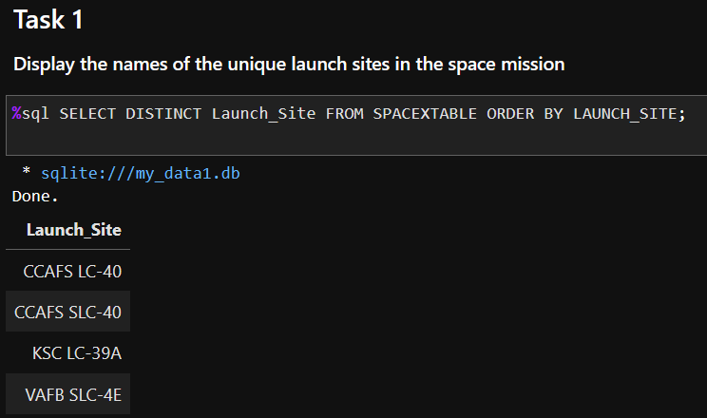
All Launch Site Names
The SQL query to identify distinct launch sites is shown on the right.
The result displays 4 unique names of launch sites.

Slide 24
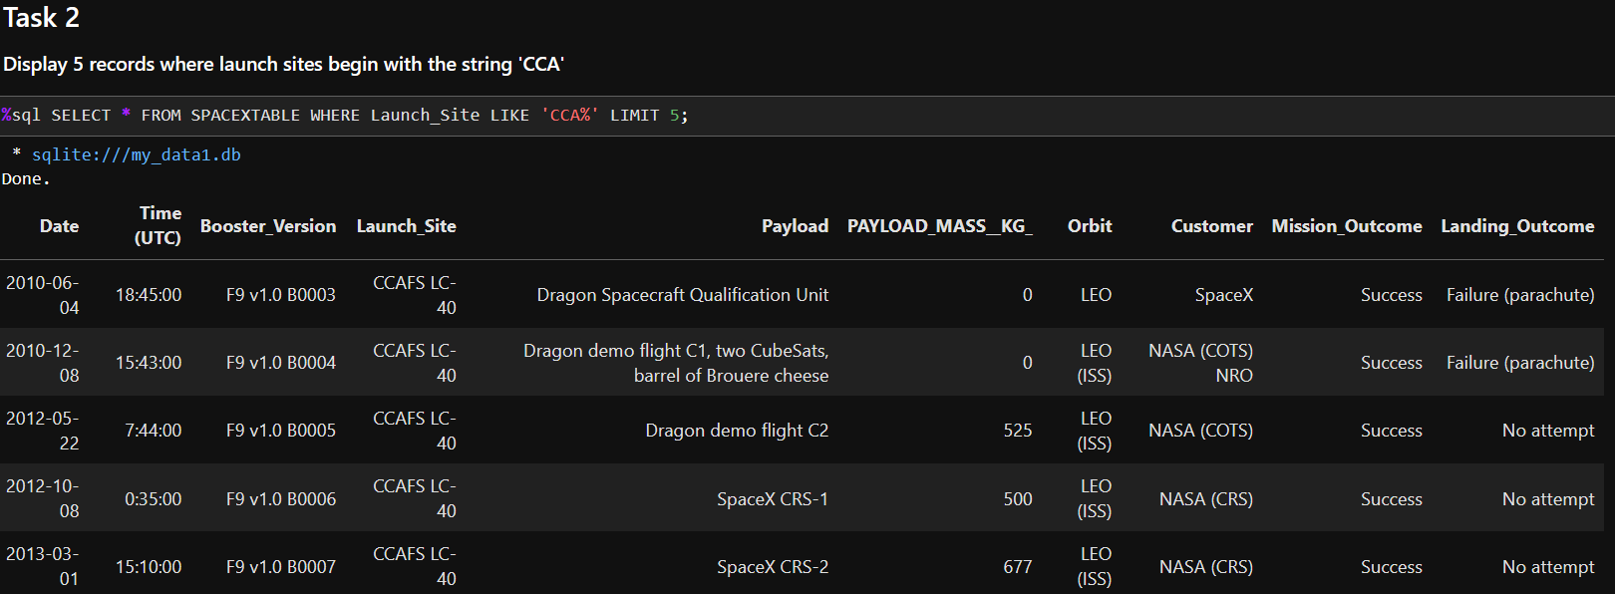
Launch Site Names Begin with 'CCA'
The SQL query to show 5 records where the launch sites begin with `CCA` is shown above.
All 5 records identified have launch sites that begin with CCA: all of these are CCAFS LC-40.

Slide 25
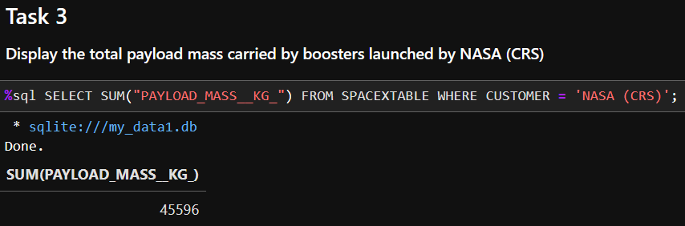
Total Payload Mass
The SQL query that calculates the total payload carried by boosters from NASA is shown above.
The mass of all payloads carried by rockets launched for NASA in this dataset is 45,596 kg.

Slide 26
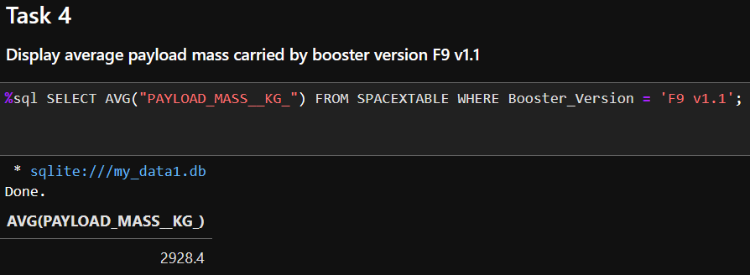
Average Payload Mass by F9 v1.1
The SQL query that calculate the average payload mass carried by booster version F9 v1.1 is shown above.
The sum of all the relevant records divided by the number of records = 2,928.4 kg.

Slide 27
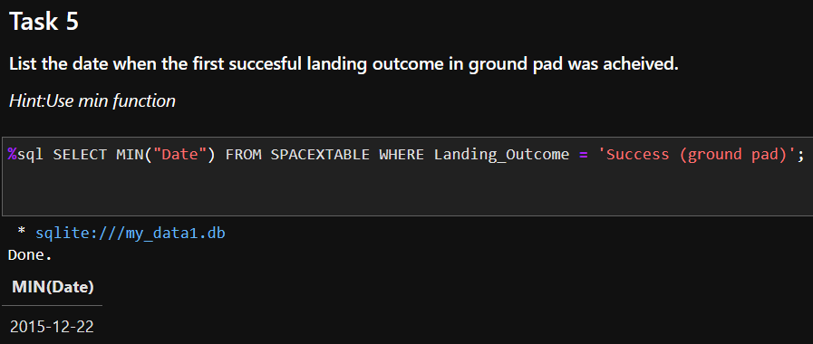
First Successful Ground Landing Date
The SQL query that shows the first date when there was a successful landing outcome on a ground pad is shown above.
The relevant date is December, 22, 2015.

Slide 28
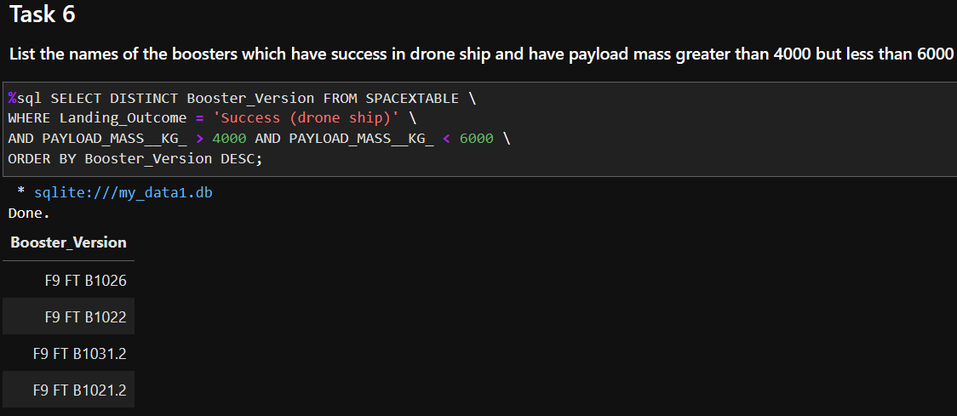
Successful Drone Ship Landing with Payload between 4000 and 6000
The SQL query that identifies the names of the booster versions that successfully landed on a drone ship with payload mass of 4000-6000 kg is shown above.
The result shows the names of 4 booster versions.

Slide 29
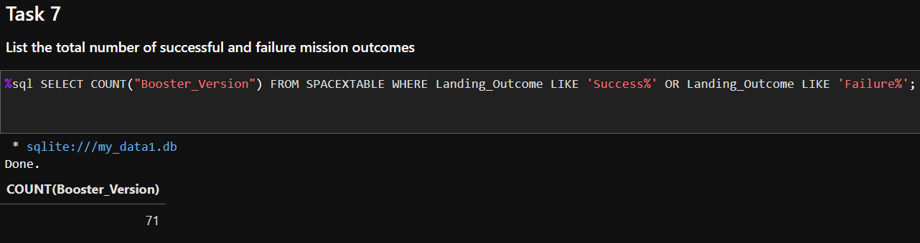
Total Number of Successful and Failure Mission Outcomes
The SQL code that produces a count of launches with either successful or failed landing outcomes is shown above.
There are 71 launches with successful or failed outcomes. Another 30 launches did not attempt a controlled landing.

Slide 30
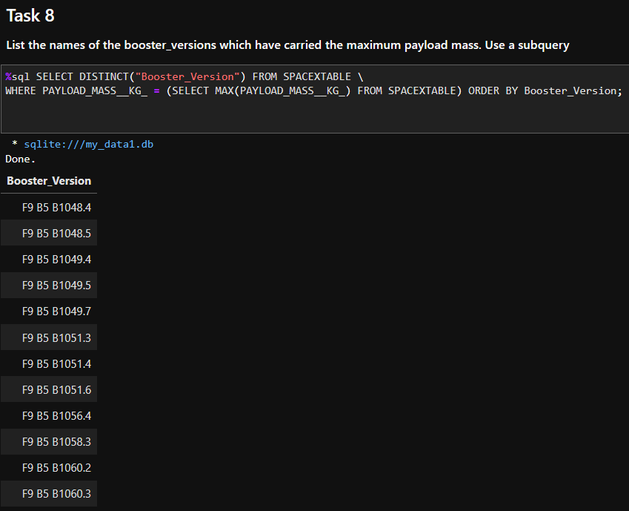
Boosters Carried Maximum Payload
The SQL query that calculates the maximum payload and then identifies the names of the booster versions that carried that maximum payload is shown to the right.
The results show 12 distinct names of Booster Versions.

Slide 31
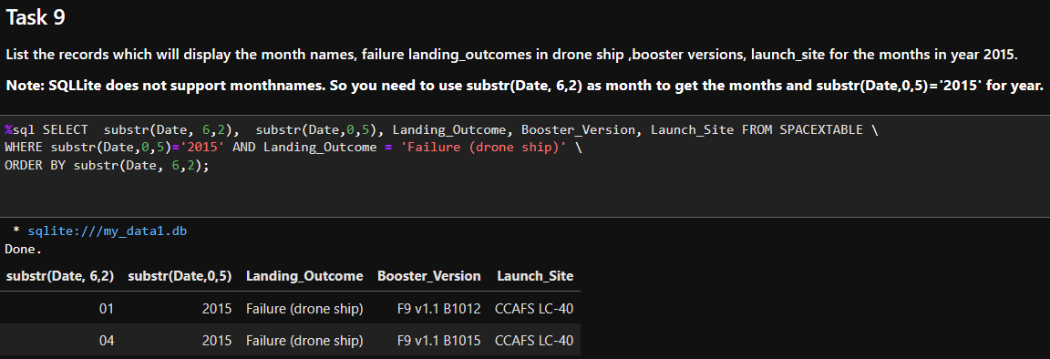
2015 Launch Records
The SQL query that lists the month, Landing Outcome, Booster Version and Launch Site for failed landing outcomes in 2015 is shown above.
There are two records that meet the requirements for this query, one in January and one in April.

Slide 32
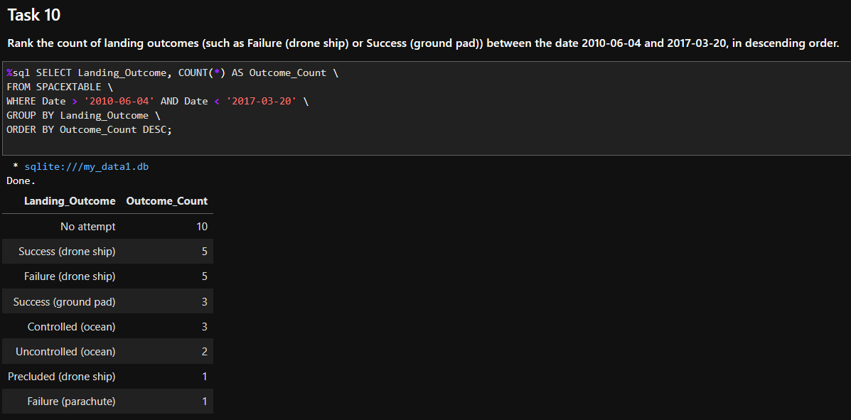
Rank Landing Outcomes Between 2010-06-04 and 2017-03-20
The SQL query that counts the number records for each type of landing outcome between the date 2010-06-04 and 2017-03-20, and then displays them in descending order by frequency, is shown above.
No Attempt is most frequent with n=10, and least frequent were Precluded (drone ship) and Failure (parachute), each with n=1.

Slide 33

Section 3

Slide 34
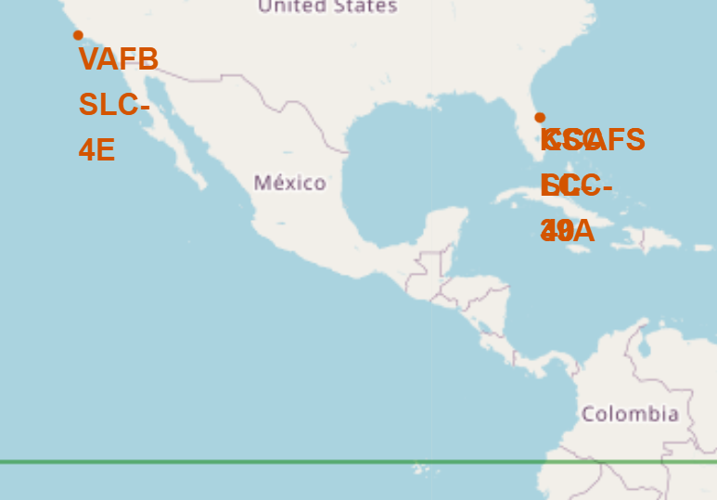
Launch Site Locations
4 Launch site locations
3 launch sites on East coast very close to each other
All launch sites near coastline to minimize risk to people and property
Launch sites also close to equator: rotational speed is greatest at equator which facilitates rockets reaching desired orbits

Slide 35
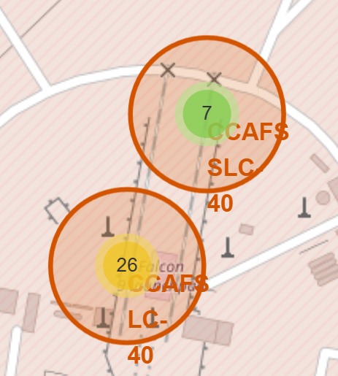
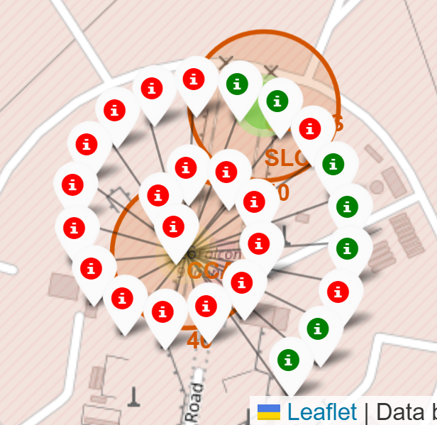
Launch Numbers and Outcomes
Two screenshots of launch sites CCAFS LC-40 and CCAFS SLC-40
Left: Number of launches from each site are indicated, 26 launches from CCAFS LC-40
Right: Launch outcomes indicated for each of the 26 launches from CCAFS LC-40

Slide 36
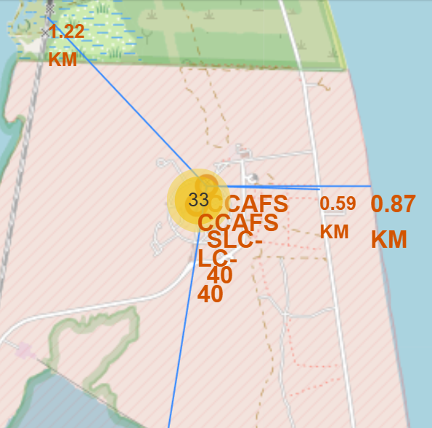
Launch Site Strategic Locations
Folium maps allow visualization and characterization of launch sites.
Proximities to cities, railways, highways, and coastlines are clearly evident and offer strategic advantages.
Map on right shows that the CCAFS SLC-40 site is very close to the nearest railway, highway and coastline.
The length of the distance to the nearest city is shown on the vertical line that extends off the bottom of this map; but is very close to Cape Canaveral, the nearest city.

Slide 37

Section 4

Slide 38
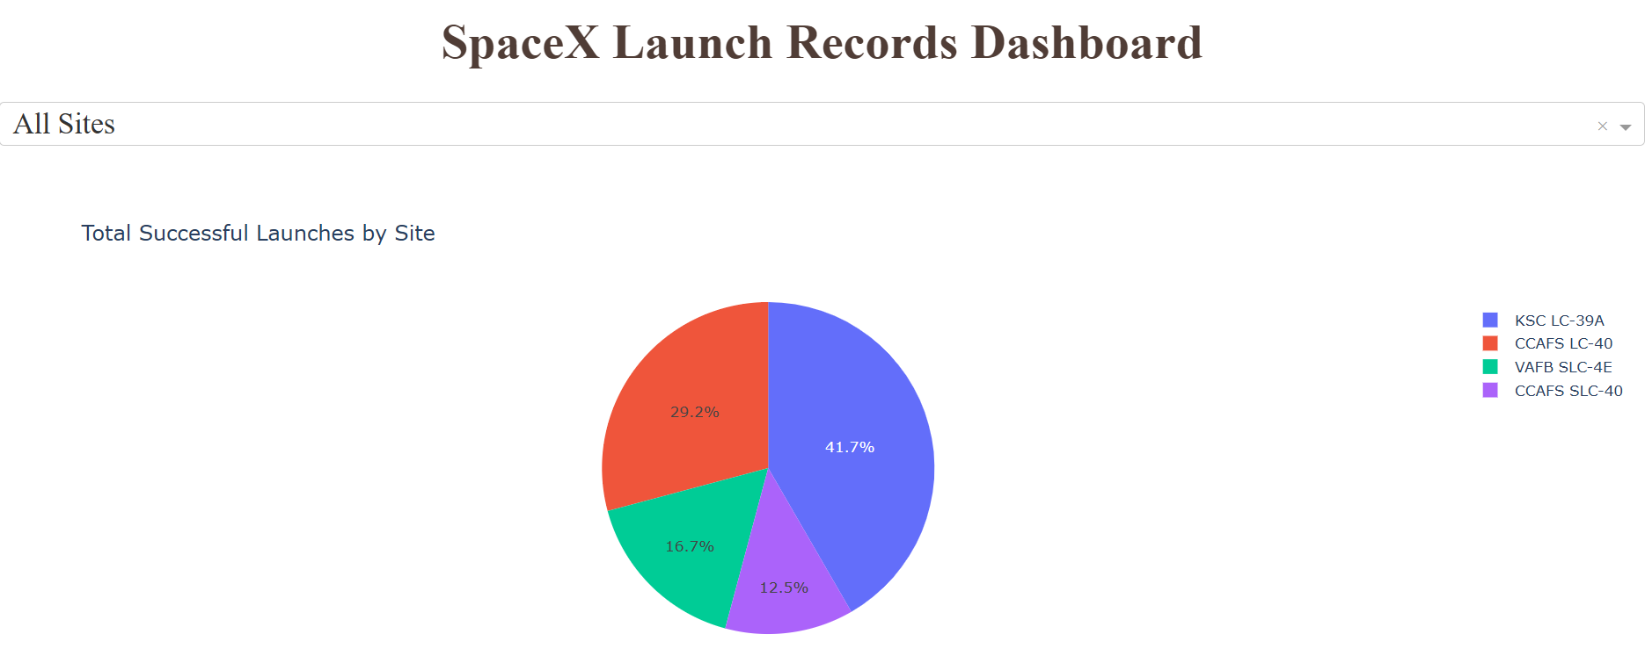
Successful Launches for SpaceX Launch Sites
Of 90 successful launches, this pie chart shows what percent of those were from each launch site.

Slide 39
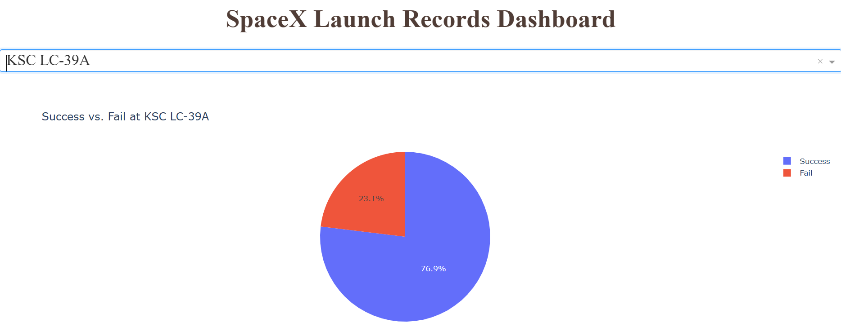
Launch Site with Highest Success Rate: KSC LC-39A
Colors for success and failure rates shown in legend on right.
Pie chart shows percent of successful and failed launches from KSC LC-39A
Launch site KSC LC-39A has the highest rate of successful launches at 76.9%

Slide 40
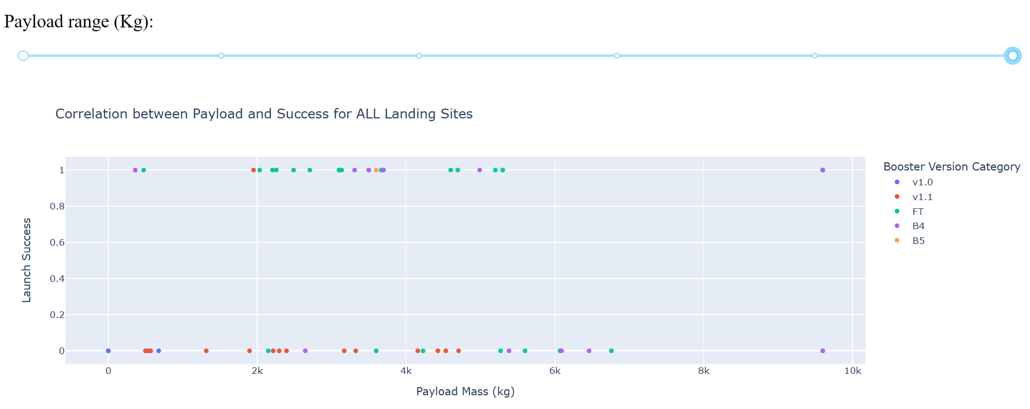
Launch Success by Payload Mass and Booster
Different booster versions are represented by colors shown in the legend to the right
Symbols represent outcomes for each launch: 0 is failed 1 is successful launch outcome
Successful vs failed launch outcomes are shown across the range of different payload masses (kg)
Most successful launches are with payloads between 2-6 kg with the FT and B4 booster versions

Slide 41

Section 5

Slide 42
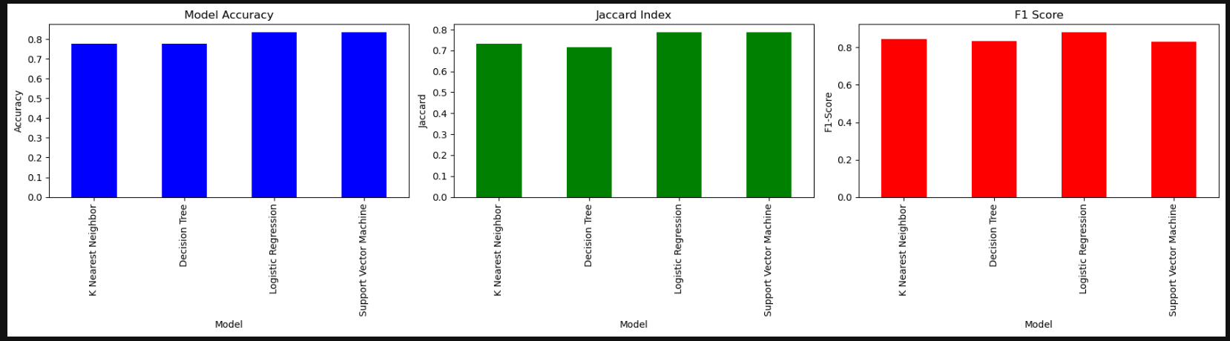
Classification Accuracy
This bar chart shows three measures of accuracy for each of the four classification models evaluated.
All four models are very good at accurately predicting the launch outcomes but the Logistic Regression model might be slightly better than the other 3 models.

Slide 43
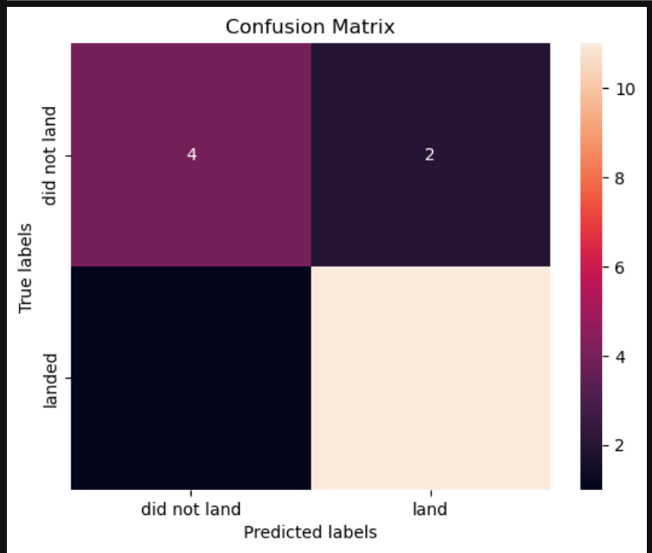
Confusion Matrix
Confusion Matrix for the Logistic Regression model using one test set of 18 records (20% of all records).
This model correctly predicts 12 launches that successfully landed and 4 launches that did not land.
The model incorrectly predicts that 2 launches that actually landed did not land.
These are the only 2 of 18 test records that are incorrectly classified with this model.
Overall, 89% of the 18 outcomes in the test data set are accurately predicted.

Slide 44

Conclusions
SpaceX provides a lot of data to the public on its launches.
Landing and re-using the first stage rockets reduces the cost of launching payloads into orbit, with a cost of 62 million compared to competitors who have costs of 165 million and higher.
Variables that are predictive of the success of landing the first stage rockets can be identified.
Models can be developed that accurately predict if a launch will successfully land the first stage rocket.
The accuracy of the predictions allows for reliable estimates of the cost and more competitive bids for launching payloads into orbit.
Accurate predictions based on all the data available and all the complicated inter-relationships between these different variables would be difficult to produce without the use of sophisticated data science tools.

Slide 45

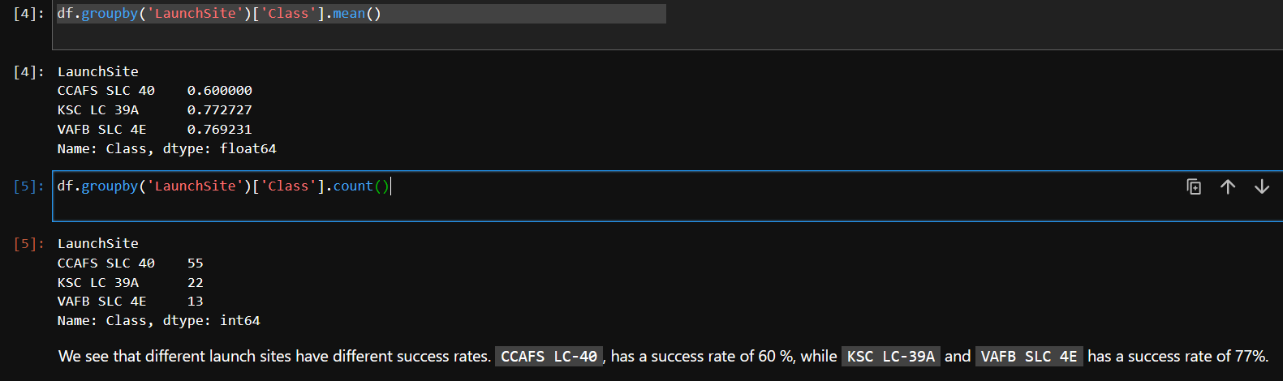
Appendix I
After producing a Flight Number by Payload Mass scatter plot, the lab instructions state, “We see that different launch sites have different success rates. CCAFS LC-40, has a success rate of 60 %, while KSC LC-39A and VAFB SLC 4E has a success rate of 77%.”
This is a nonsequator since neither the scatter plot we just produced nor any of the previous analyses conducted showed the number of launches or success rates for each launch site.
The code above was added to show the success rates for each launch site.

Slide 46
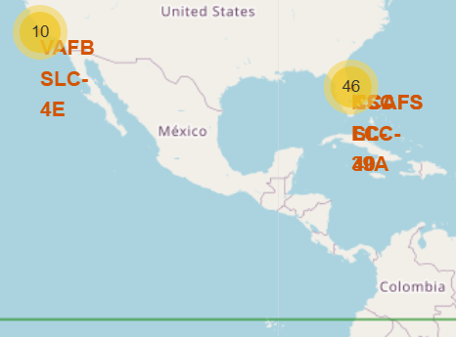
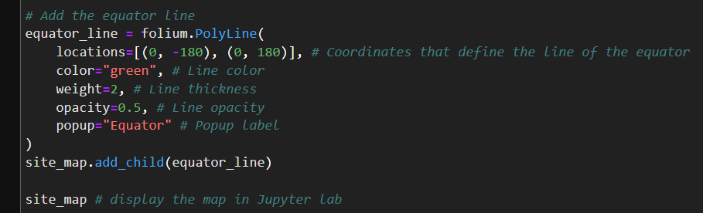
Appendix II
At one point, the text in the lab states, “…Are all launch sites in proximity to the Equator line?”
The equator is not shown on the map so I added code to add it.
The code is shown in the box on the left and the map with the equator is shown in the map on the right.

Slide 47


